Slide 1

PRODUCT PRESENTATION
THE THEOS LAPTOP TABLE
EFFICIENT TECHNOLOGY

Slide 2


About Us
Creating a flexible lifestyle where single usage products are of the past
Founded in 2010
Had designed, created & produced numerous world-class products
(2015 - 2019 Red Dot Design Award Holder)
Has shipped more than 500,000 products nationwide
Proven track record in product quality & reliability.

Slide 3
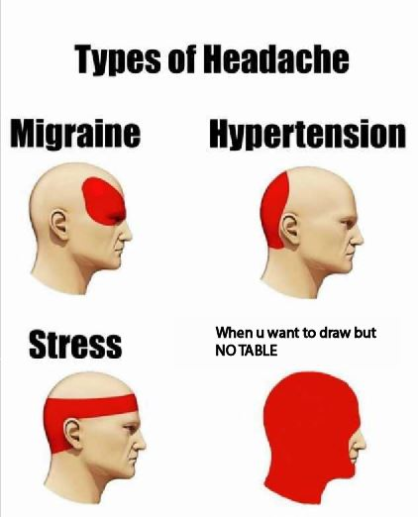
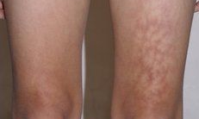
PROBLEMS
Burnt Thigh Caused By Laptop Heat

Slide 4
THE THEOS LAPTOP TABLE
INTRODUCING OUR LATEST PRODUCT

Slide 5
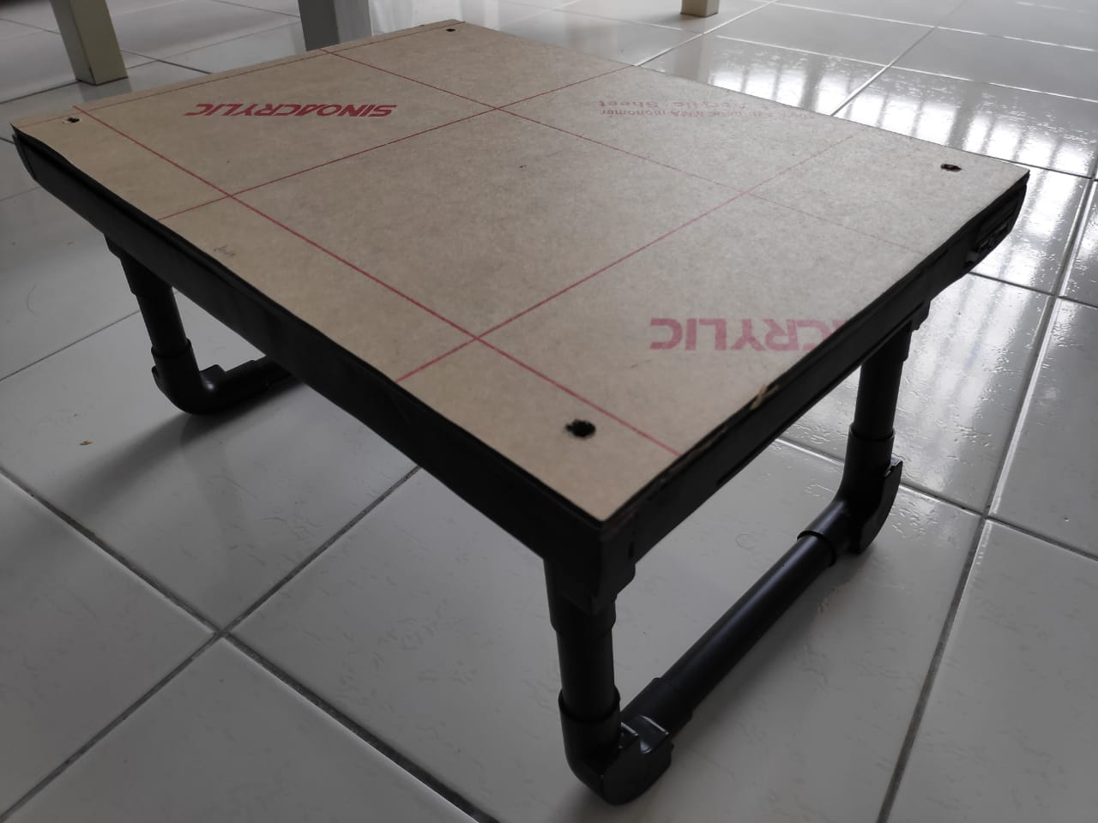
MULTIFUNCTIONAL
LIGHTWEIGHT
PORTABLE
SLICK DESIGN
DURABLE
TRANSFORMING LIFES,
A BETTER FUTURE

Slide 6
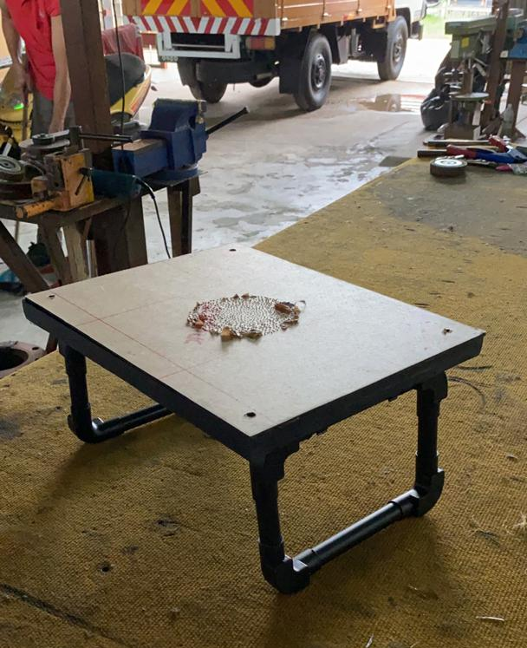
SPECIFICATION
7 Layers of lightweight, gloss-black acrylic
Foldable legs
Retractable mousepad and drawer
A large, USB powered fan
Anti-slip material at the legs
Replaceable top plate *Includes an additional flat top plate for drawing

Slide 7
DIMENSIONS
Dimension | Table | Drawer | Mousepad
Width | 295mm | 138mm | 178mm
Length | 392mm | 140mm | 159mm
Height | 38mm (Folded) 141mm (Extended) | 2.5mm | 2.5mm

Slide 8
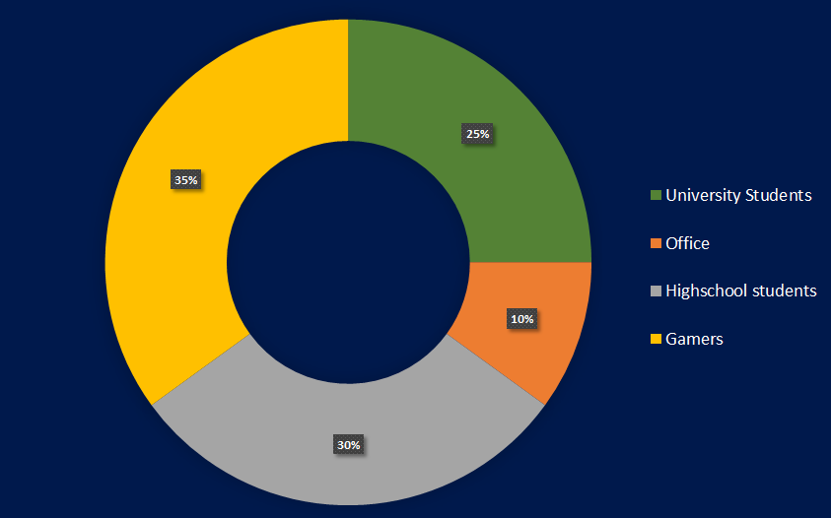
Targeted Consumers
University Students
Office
Highschool students
Gamers

Slide 9
The Selling Price
With Different Colors & Feature
Colour | With Replaceable Top Plate | Only Replaceable Top Plate | Without Replaceable Top Plate
Black | RM70 | RM25 | RM50
Red | RM80 | RM35 | RM60
Yellow | RM80 | RM35 | RM60
Blue | RM80 | RM35 | RM60
RENT TO USE BEFORE PURCHASING
2 – MONTHS INSTALMENT PAYMENT ARE AVAILABLE

Slide 10

Our Promise
EXCELLENCE IN CUSTOMER SERVICE
Maintenance-free product
PRODUCT SUPPORT
2 Years of on-site product support which includes warranty will be provided.
Free Postal Services for all warranty claims or walk into our authorized dealer for claims
Sufficient supply of replacement parts
(for which applies)

Slide 11
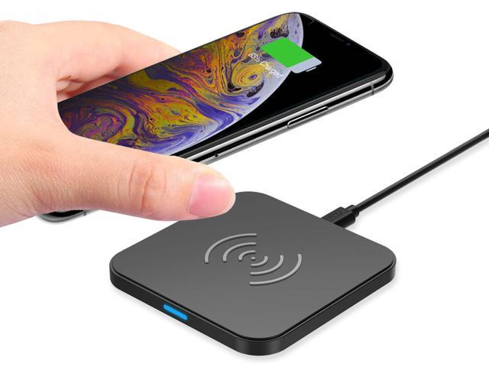
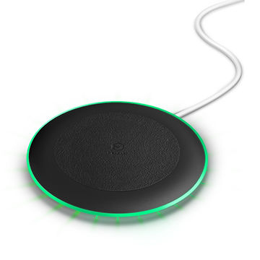
Our Future Product 1
The Wireless Charger
Higher charging speed with lesser heat produces.
Durable, 2 years of warranty is provided.
Will be launching within two months.
Keep yourself update with us
-To follow our Facebook:
ETech_1008
-Our Instagram:
ETech_1008

Slide 12

Our Future Product 2
Internet-of-things
Controls everything electrical in your home when you're working on the computer
Our most ambitious add-on yet
Ready in a year
Keep yourself update with us
-To follow our Facebook:
ETech_1008
-Our Instagram:
ETech_1008

Slide 13

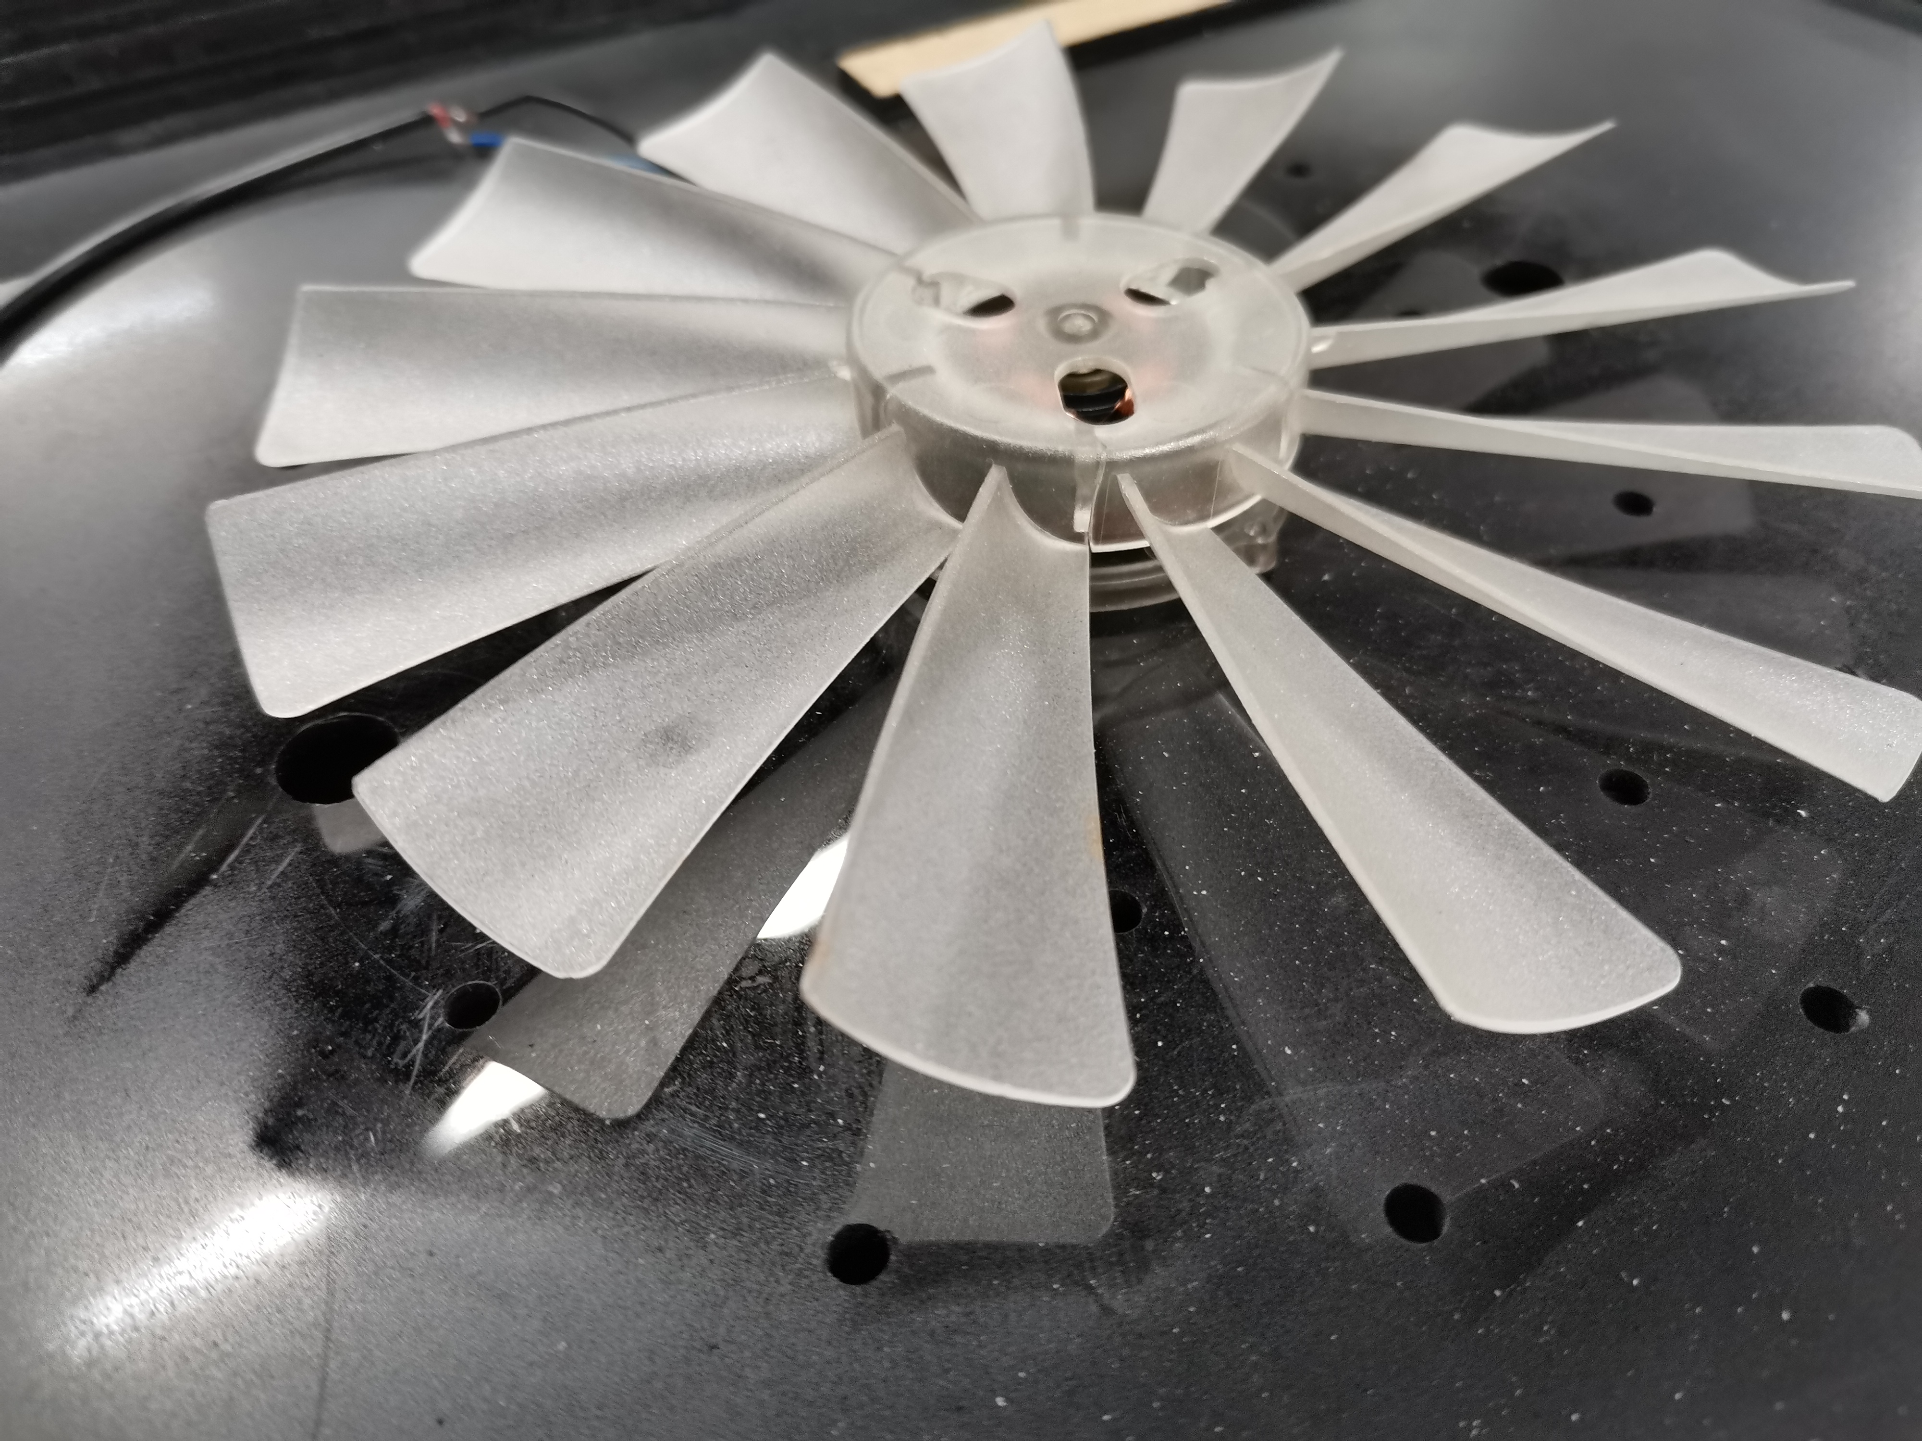
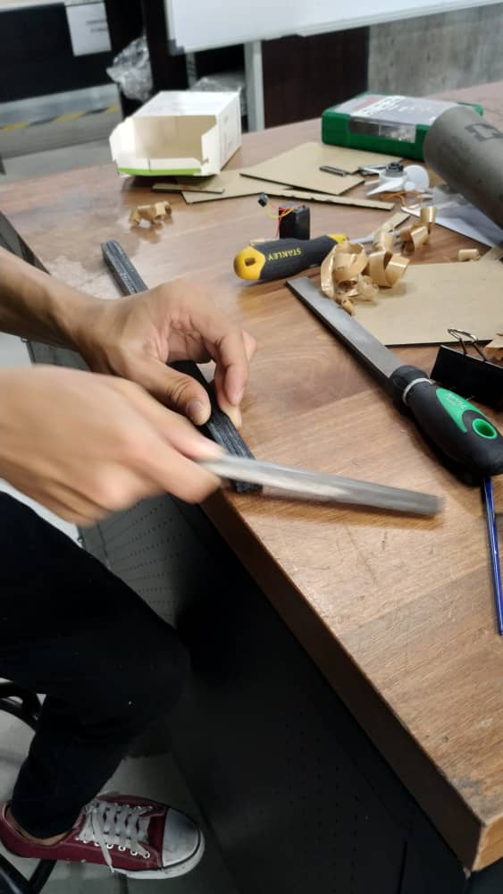
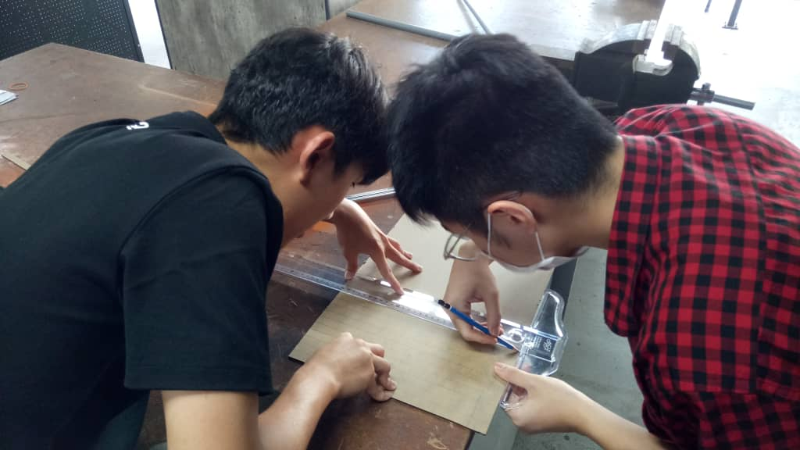
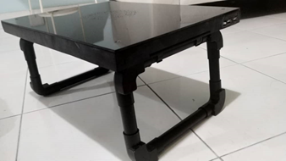
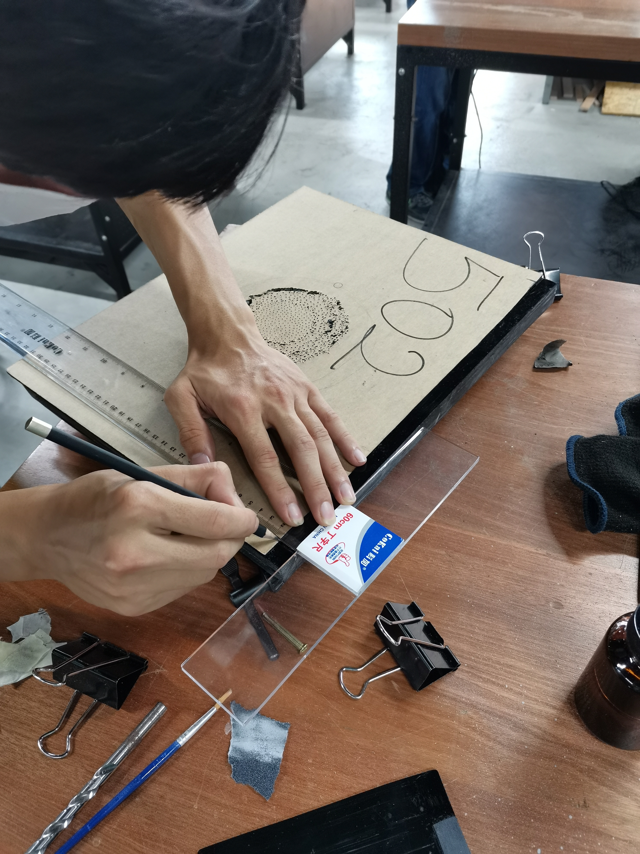
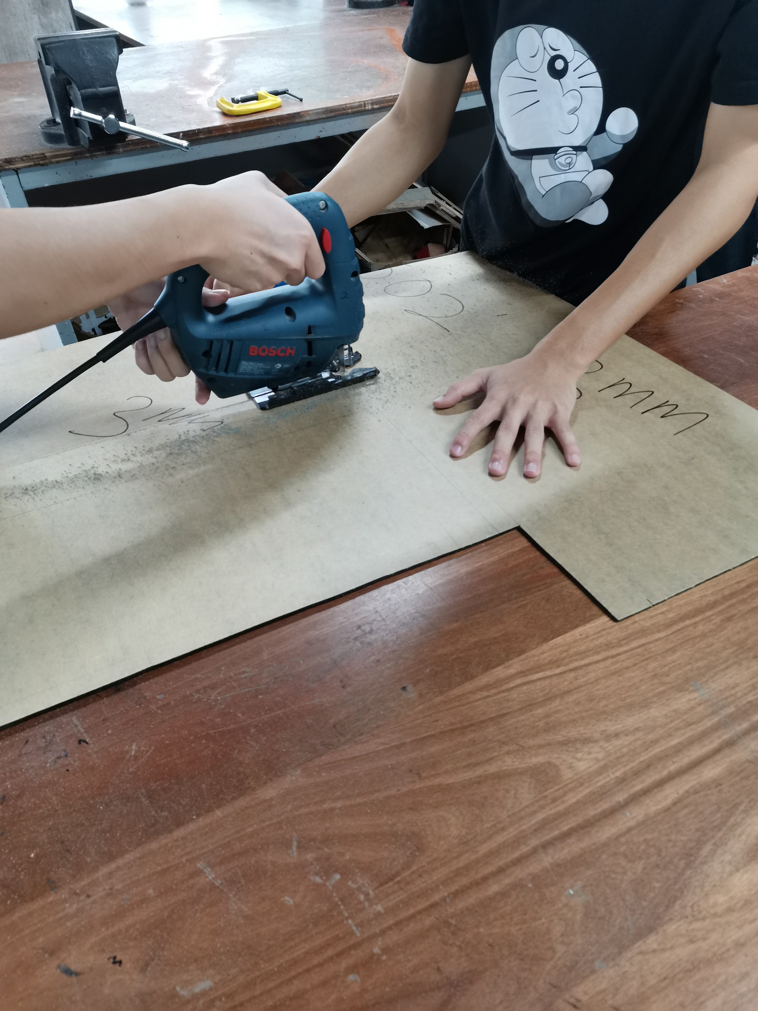
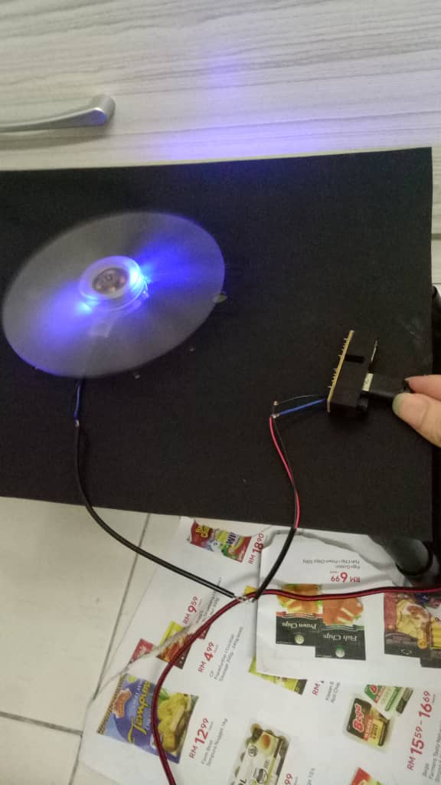
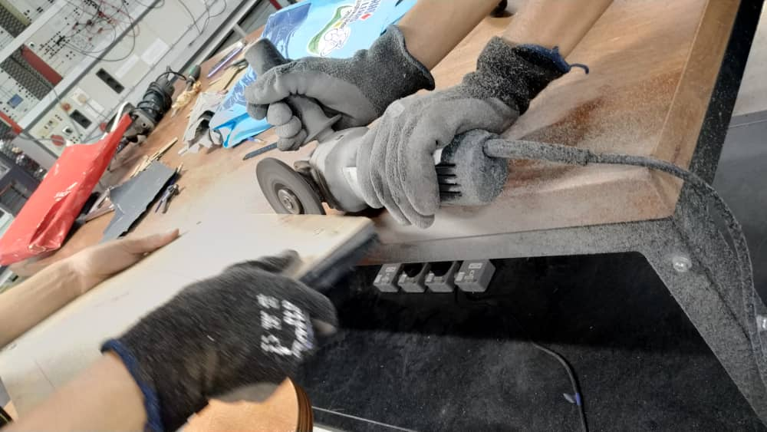
MADE BY STUDENTS FOR STUDENTS

Slide 14

Thank You.
EFFICIENT TECHNOLOGY
Efficient Technology
0172091168
1001955904@ucsiuniversity.edu.my
www.efficienttechnology.com.my

